Slide 1


Slide 2

DWELL
Digital Well-being: A Holistic Approach for Well-
being in the Broader Digital Education Ecosystem
ꢀꢀPresentedꢀby:ꢀMariaꢀKnais
ꢁꢀCoordinatedꢀby:ꢀEDITC
ꢂꢀPressꢀConferenceꢀ24ꢀJuneꢀ2025

Slide 3

The DWELL Project
DWELLꢀisꢀaꢀ3-yearꢀErasmus+ꢀprojectꢀ(2025–2028)ꢀaimingꢀtoꢀaddressꢀ
DigitalꢀWellꢀBeingꢀofꢀStudents
ItꢀisꢀaꢀtransnationalꢀeffortꢀwithꢀpartnersꢀfromꢀCyprus,ꢀRomania,ꢀ
Bulgaria,ꢀFinland,ꢀGreeceꢀandꢀPolandꢀcollaboratingꢀtoꢀintroduceꢀ
DigitalꢀWellꢀBeingꢀinꢀSchools

Slide 4
What is Digital Well Being?
Digitalꢀwell-beingꢀcanꢀbeꢀunderstoodꢀasꢀaꢀfeelingꢀofꢀphysical,ꢀmental,ꢀ
cognitive,ꢀsocialꢀandꢀemotionalꢀcontentmentꢀthatꢀenablesꢀallꢀ
individualsꢀtoꢀengageꢀpositivelyꢀinꢀallꢀdigitalꢀlearningꢀenvironmentsꢀ
ꢀthroughꢀdigitalꢀeducationꢀandꢀtraining,ꢀtoolsꢀandꢀmethods,ꢀ
maximisingꢀtheirꢀpotentialꢀandꢀself-realisationꢀandꢀhelpsꢀthemꢀtoꢀactꢀ
safelyꢀonline,ꢀsupportingꢀtheirꢀempowermentꢀinꢀonlineꢀenvironments.ꢀ

Slide 5
The Need for Digital Wellbeing in
Education
• Post-COVID-19,ꢀdigitalꢀengagementꢀinꢀeducationꢀsurgedꢀrapidly.
• Digitalꢀlearningꢀhasꢀbothꢀpositive outcomes and negative
impacts
• Positive impacts:ꢀaccessibility,ꢀcost-effectiveness,ꢀimmersiveꢀ
experiences,ꢀcollaboration,ꢀpersonalizedꢀlearning
• Negative impacts: reducedꢀsocialꢀinteraction,ꢀCyberbullying,ꢀ
privacyꢀbreaches,ꢀscreenꢀtimeꢀimpactsꢀonꢀphysicalꢀandꢀmentalꢀ
health,ꢀincreasedꢀstressꢀandꢀloneliness

Slide 6
Insights from Research
Negative Impacts Identified:
Positive Influences Found:
• Reducedꢀmotivationꢀdueꢀtoꢀlackꢀ
• Higherꢀsatisfactionꢀamongꢀ
ofꢀin-personꢀsupportꢀ(Usherꢀetꢀal.,ꢀ studentsꢀwithꢀpriorꢀdigitalꢀ
2021;ꢀAguilera,ꢀ2020)
experienceꢀ(Hamdanꢀetꢀal.,ꢀ2021;ꢀ
Landrumꢀetꢀal.,ꢀ2020)
• Well-structuredꢀsynchronousꢀandꢀ
asynchronousꢀcourseꢀformatsꢀ
improveꢀsatisfactionꢀ(Zengꢀ&ꢀ
Wang,ꢀ2021)
• Increasedꢀstress,ꢀloneliness,ꢀandꢀ
academicꢀpressureꢀduringꢀ
isolationꢀ(Huangꢀ&ꢀZhang,ꢀ2022;ꢀ
Mendozaꢀetꢀal.,ꢀ2020)
• Needꢀforꢀbetter-designedꢀdigitalꢀ
supportꢀsystemsꢀ(e.g.,ꢀchatꢀroomsꢀ • Digitalꢀmaterialsꢀcanꢀenhanceꢀ
etc)
socialꢀskillsꢀmoreꢀthanꢀtraditionalꢀ
methodsꢀ(Sariyatunꢀetꢀal.,ꢀ2021)

Slide 7
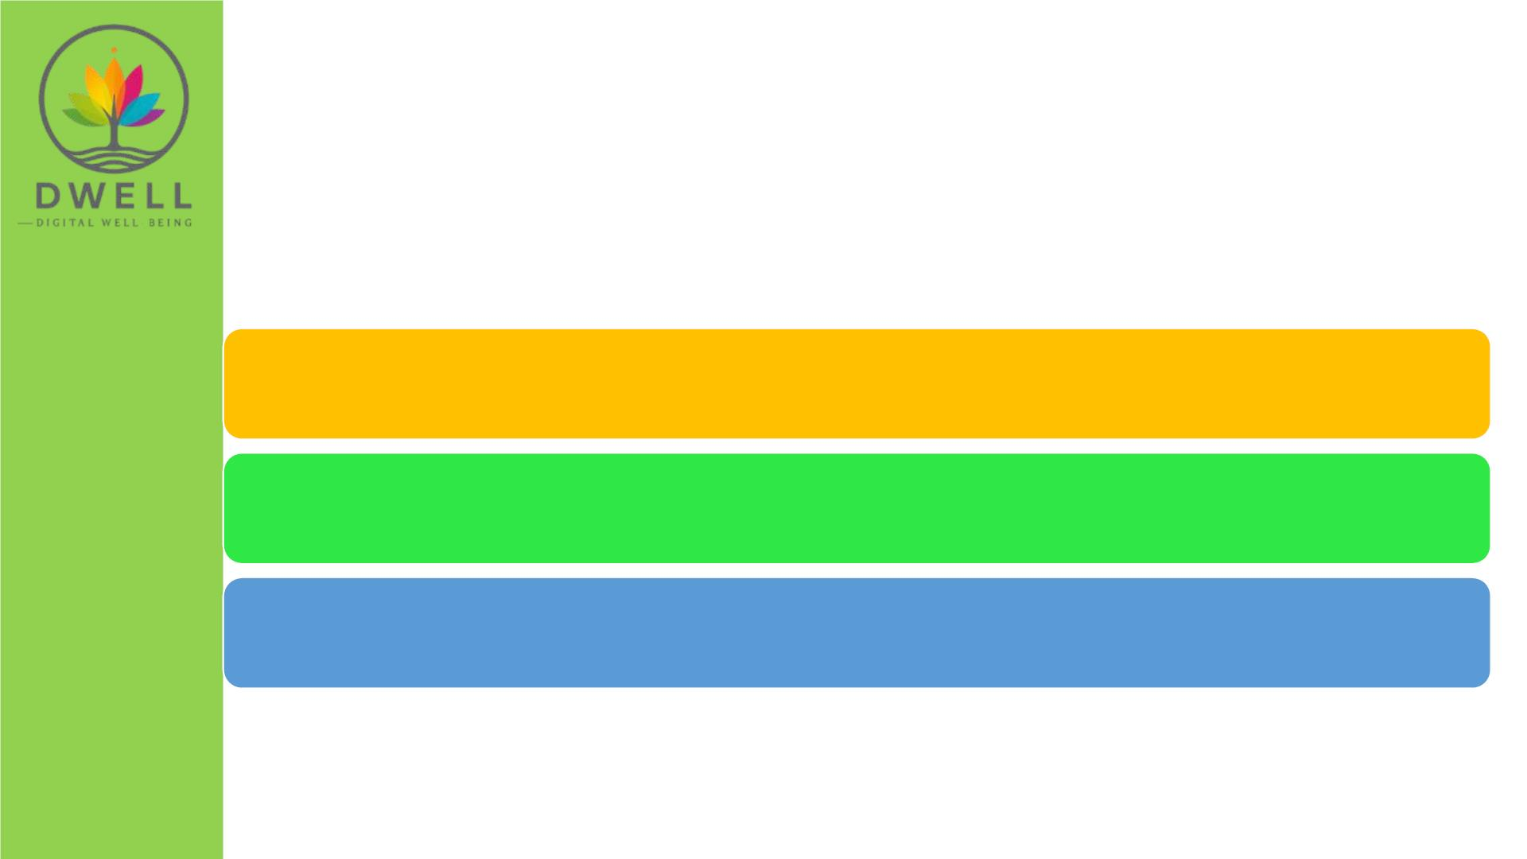
Key factors influencing student
experience:
Digitalꢀcompetenciesꢀofꢀstudents
SupportꢀfromꢀteachersꢀandꢀParents
HowꢀlearningꢀisꢀstructuredꢀinꢀDigitalꢀEnvironments

Slide 8

Digital Well Being is a complex concept that
can be viewed from a variety of perspectives
Individualꢀperspectiveꢀ
Identifyingꢀandꢀunderstandingꢀtheꢀbenefitsꢀandꢀanyꢀpotentialꢀ
negativeꢀaspectsꢀofꢀengagingꢀwithꢀdigitalꢀactivitiesꢀandꢀbeingꢀ
awareꢀofꢀwaysꢀtoꢀmanageꢀandꢀcontrolꢀtheseꢀtoꢀimproveꢀ
wellbeingꢀ

Slide 9
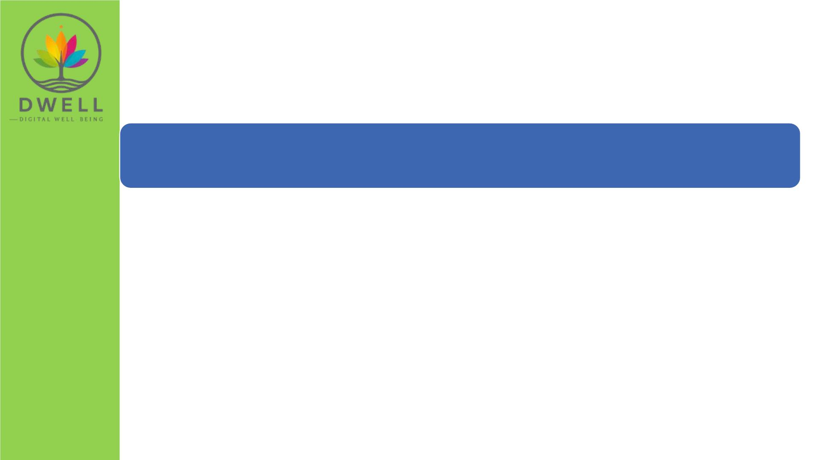
Digital Well Being is a complex concept that
can be viewed from a variety of perspectives
Educationalꢀservicesꢀperspective
educators,ꢀprovidersꢀofꢀdigitalꢀsystems,ꢀservicesꢀandꢀcontentꢀ
haveꢀaꢀresponsibilityꢀforꢀensuringꢀthatꢀtheseꢀareꢀwellꢀmanaged,ꢀ
supported,ꢀaccessibleꢀandꢀequitable.ꢀTheyꢀalsoꢀneedꢀtoꢀ
empowerꢀandꢀbuildꢀcapabilityꢀinꢀusersꢀsoꢀthatꢀallꢀwhoꢀengageꢀ
withꢀthemꢀareꢀequippedꢀtoꢀdoꢀsoꢀinꢀaꢀwayꢀthatꢀsupportsꢀand/orꢀ
improvesꢀtheirꢀwellbeing.ꢀTheyꢀneedꢀtoꢀfosterꢀdigitalꢀwellꢀbeingꢀ
inꢀtheirꢀpracticesꢀasꢀtheyꢀplayꢀanꢀimportantꢀroleꢀinꢀshapingꢀtheꢀ
digitalꢀwell-beingꢀtoꢀstudentsꢀ

Slide 10

Digital Well Being is a complex concept that
can be viewed from a variety of perspectives
Parentsꢀperspectiveꢀ
Asꢀtheꢀguardiansꢀofꢀyoungꢀlearners,ꢀparentsꢀhaveꢀaꢀresponsibilityꢀ
toꢀensureꢀtheꢀoverallꢀwell-beingꢀofꢀtheirꢀchildren,ꢀincludingꢀdigitalꢀ
wellbeing.ꢀTheyꢀneedꢀtoꢀbeꢀawareꢀofꢀhowꢀdigitalꢀtechnologiesꢀcanꢀ
impactꢀtheꢀwellbeingꢀofꢀyoungsters,ꢀwatchꢀoutꢀforꢀanyꢀindicatorsꢀ
andꢀprovideꢀsupportꢀandꢀguidance.ꢀ

Slide 11

Teachers and Parents have a
central role in Digital Well
Being

Slide 12
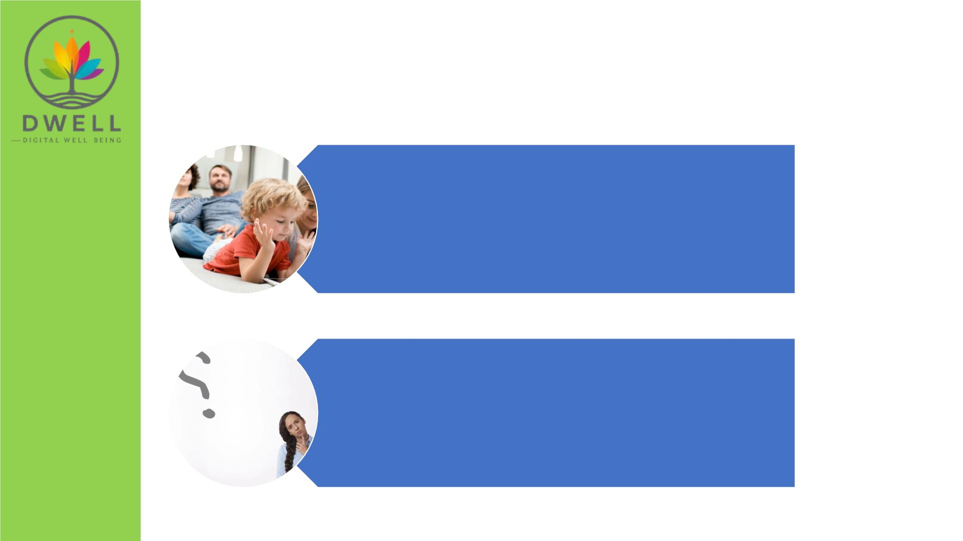
Daily Gatekeepers of Digital Experiences
Parentsꢀandꢀteachersꢀshape
children’s daily routinesꢀwithꢀ
technology.
Theirꢀchoicesꢀdirectlyꢀinfluenceꢀ
screen time, content exposure,ꢀ
andꢀonline behaviors.

Slide 13

Role Models for Healthy Digital Habits
Childrenꢀmimicꢀadultꢀbehavior—
educatorsꢀandꢀparentsꢀmustꢀ
demonstrate balanced, mindful useꢀ
ofꢀtechnology.
Modelingꢀincludes:ꢀsettingꢀ
boundaries,ꢀpracticingꢀonlineꢀsafety,ꢀ
managingꢀdigitalꢀdistractions.

Slide 14

First Responders to Risks and Challenges
Parents and teachers are often the
first to notice signs of digital stress,
cyberbullying or disengagement
Theirꢀresponseꢀdeterminesꢀhowꢀ
quicklyꢀandꢀeffectivelyꢀsupportꢀisꢀ
provided.

Slide 15
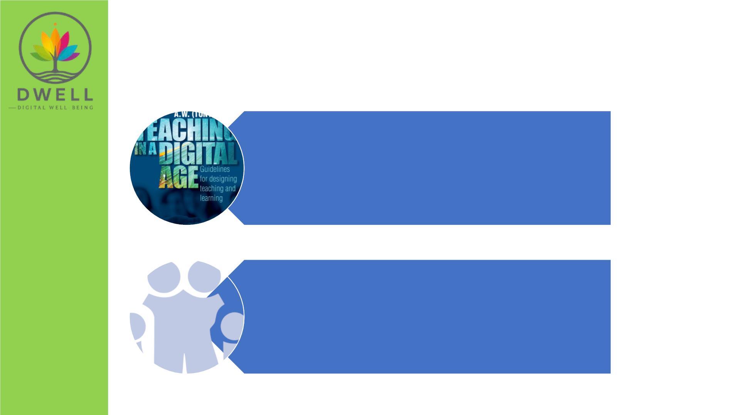
Architects of Learning Environments
Educatorsꢀdesignꢀdigitalꢀlearningꢀ
experiences,ꢀwhileꢀparentsꢀhelpꢀ
reinforceꢀlearningꢀatꢀhome.
Together,ꢀtheyꢀco-createꢀsafe,ꢀ
supportive,ꢀandꢀengagingꢀdigitalꢀ
ecosystems.

Slide 16

Trusted Sources of Guidance
Childrenꢀturnꢀtoꢀtrustedꢀ
adultsꢀforꢀemotionalꢀ
supportꢀandꢀdigitalꢀadvice.
Empoweredꢀadultsꢀ=ꢀ
empoweredꢀchildrenꢀinꢀ
navigatingꢀtheꢀdigitalꢀworld.

Slide 17
The Core Challenge
Ensuringꢀthatꢀincreasedꢀdigitalizationꢀdoesꢀnotꢀcompromiseꢀ
mental health, social connection, or educational quality among
students/youngsters

Slide 18
Our focus in Dwell
TeachersꢀandꢀParentsꢀempoweredꢀtoꢀco-createꢀsafeꢀdigitalꢀ
environmentsꢀandꢀsafeꢀengagementꢀwhileꢀdigitalꢀlearningꢀtakesꢀ
place

Slide 19
Why DWELL?
• Existingꢀframeworksꢀ(e.g.,ꢀUKꢀDigitalꢀWellbeingꢀFramework,ꢀ
ISTEꢀStandards)ꢀprovideꢀgeneral guidance,ꢀbutꢀdon’tꢀfocusꢀonꢀ
learners’ꢀwellbeing.
• ToolsꢀlikeꢀSELFIEꢀassessꢀdigitalꢀpracticesꢀbutꢀdo not measure
digital wellbeingꢀimpacts.
• Currentꢀcertificationsꢀ(e.g.,ꢀGoogleꢀDigitalꢀWellbeing)ꢀareꢀnot
specialized or comprehensive.

Slide 20
Why it matters?
ꢀꢀAlignedꢀwith:
• DigitalꢀEducationꢀActionꢀPlanꢀ(2021–2027)
• AꢀplanꢀbyꢀtheꢀEUꢀtoꢀimproveꢀdigitalꢀlearningꢀinꢀschoolsꢀandꢀmakeꢀsureꢀteachersꢀandꢀ
studentsꢀhaveꢀstrongꢀdigitalꢀskills.
• EuropeanꢀSkillsꢀAgenda
• AꢀstrategyꢀtoꢀhelpꢀpeopleꢀinꢀEuropeꢀlearnꢀtheꢀrightꢀskillsꢀ(especiallyꢀdigitalꢀones)ꢀforꢀ
jobs,ꢀgrowth,ꢀandꢀlifelongꢀlearning.
• EUꢀStrategyꢀonꢀChildren’sꢀRights
• Aꢀframeworkꢀtoꢀprotectꢀchildren’sꢀrightsꢀacrossꢀEurope,ꢀincludingꢀsafetyꢀonline,ꢀ
education,ꢀandꢀmentalꢀwell-being.

Slide 21
The DWELL Vision
Toꢀcreateꢀdigitally healthy learning ecosystemsꢀthatꢀmaximizeꢀ
theꢀbenefitsꢀofꢀdigitalꢀlearningꢀwhileꢀaddressingꢀitsꢀchallenges.

Slide 22

The DWELL Project Response
Deliverꢀpolicy recommendationsꢀ
forꢀsustainableꢀchange
Integrateꢀdigital well-beingꢀintoꢀ
educationꢀsystems
Equipꢀeducators and parentsꢀwithꢀ
theꢀtoolsꢀtoꢀsupportꢀstudents
Developꢀandꢀpilotꢀaꢀpracticalꢀ
framework, assessment, and
certifications

Slide 23
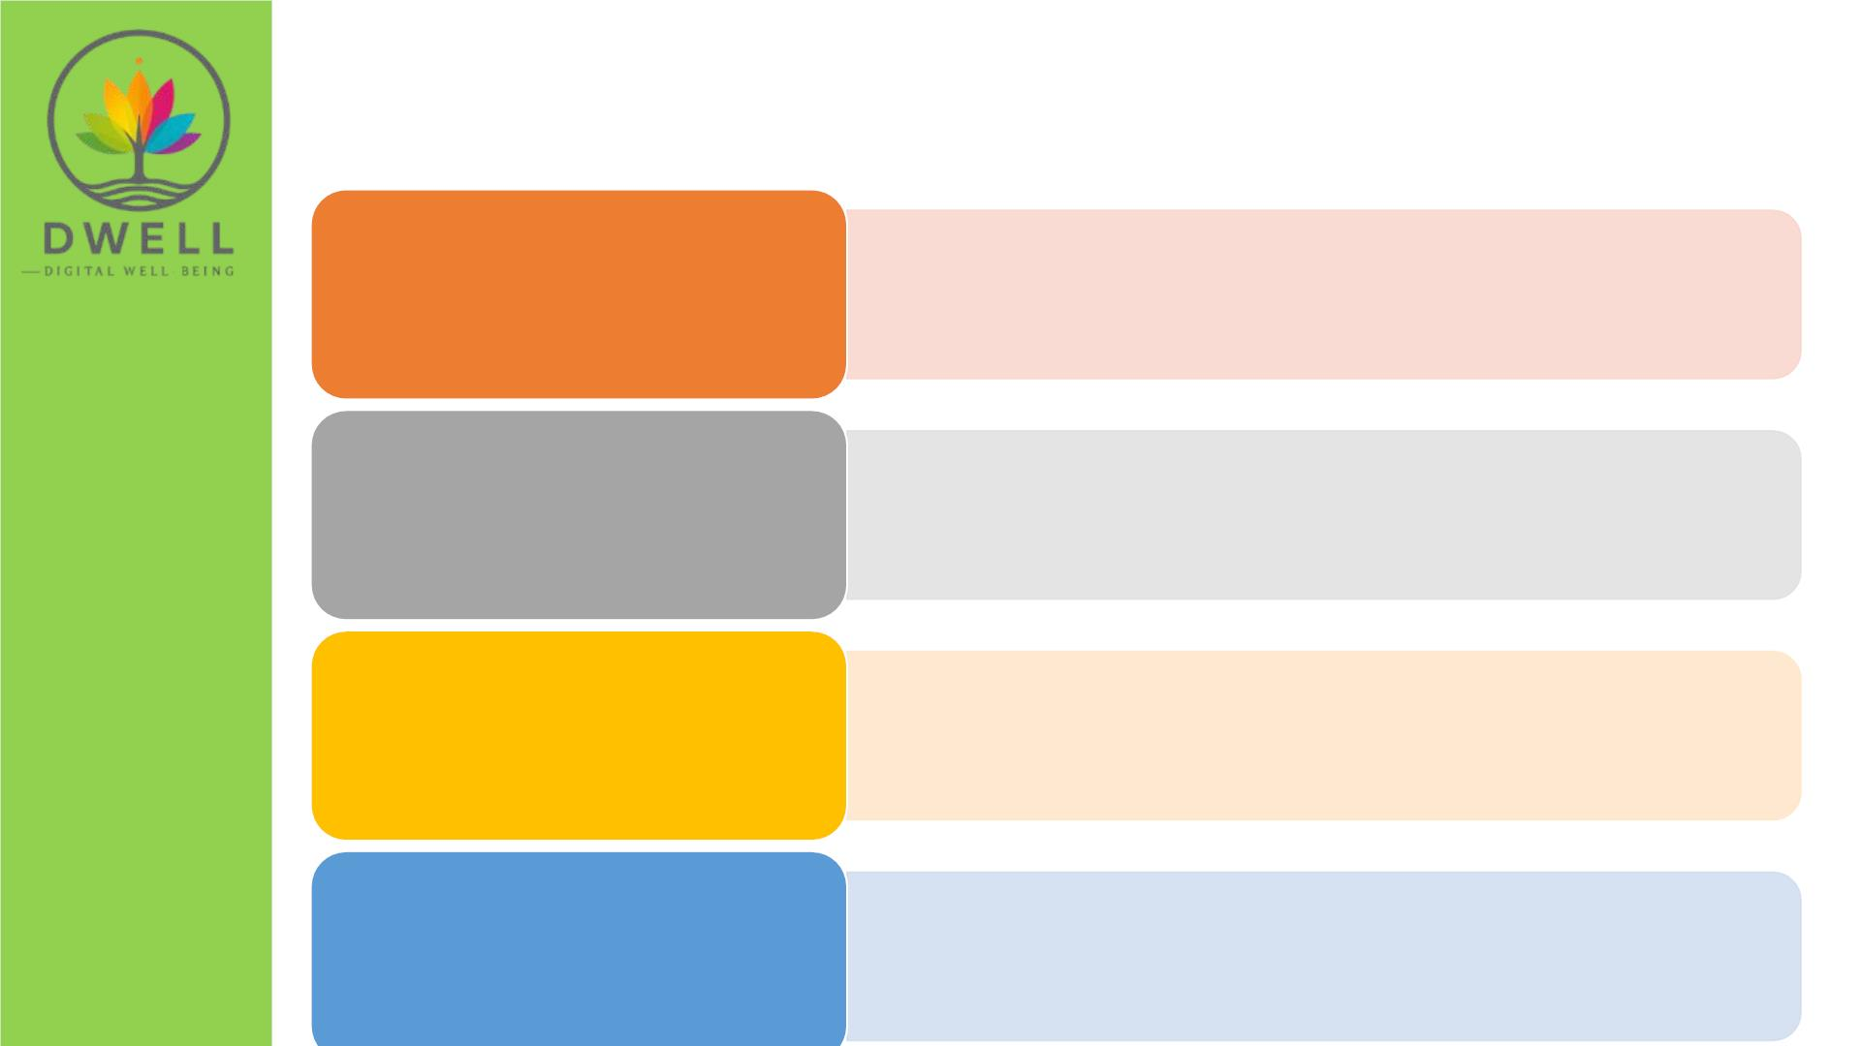
DWELL Journey
• ConfirmꢀDomains:ꢀPhysical,ꢀmentalꢀandꢀemotional,ꢀsocialꢀ
andꢀcognitive
• CurrentꢀPracticesꢀofꢀeducatorsꢀandꢀParents
WP2:ꢀResearch
• Identifyꢀtheꢀkeyꢀdomains
WP3:ꢀFRAMEꢀDWELLꢀ
• Analyzeꢀthemꢀintoꢀareasꢀofꢀconcern/interestꢀ(AoIs/AoCs)
• Describeꢀcompetencesꢀforꢀeducatorsꢀandꢀparents.
WP4:ꢀASSESS,ꢀCERTIFY,ꢀ
AWARE
• ASSESS-ꢀDWELL
• CERTIFY-DWELLꢀinꢀ2ꢀlevels.
• AWARE-DWELLꢀforꢀParents
POLICYꢀ
RECOMMENDATIONSꢀ
ANDꢀTRANSFERABILITY
• Developꢀandꢀadvocateꢀforꢀevidence-basedꢀpolicyꢀ
recommendationsꢀthatꢀenhanceꢀdigitalꢀwellbeingꢀinꢀ
educationalꢀsettings

Slide 24
Key Deliverables
• Aꢀframeworkꢀwithꢀtips,ꢀskills,ꢀandꢀactionsꢀforꢀpromotingꢀdigitalꢀ
well-being.
• Aꢀself-check toolꢀforꢀteachersꢀtoꢀseeꢀhowꢀwellꢀtheyꢀsupportꢀdigitalꢀ
well-being.
• Online coursesꢀforꢀteachersꢀandꢀparents,ꢀavailableꢀinꢀ6ꢀlanguages.
• Badges and certificatesꢀforꢀeducatorsꢀwhoꢀcompleteꢀtheꢀtraining.
• Workshopsꢀandꢀeventsꢀtoꢀshareꢀtheꢀresultsꢀandꢀideasꢀwithꢀothers.
• Policy recommendationsꢀforꢀschoolsꢀandꢀgovernments.

Slide 25

Meet our Partners
EDITCꢀ–ꢀ
Cyprus
ARAD
VAMK
ACTA
Romania Finland
Bulgaria
CCS
KLS
MMC
DIMITRA
Greece
ꢀCyprus
Poland
Cyprus

Slide 26
WP1 – Project Management
Lead:ꢀEDITC
ꢂꢀAprilꢀ2025ꢀ–ꢀMarchꢀ2028
• Partnerꢀagreementsꢀ&ꢀprojectꢀhandbook
• Qualityꢀassuranceꢀtools
• Bi-monthlyꢀcoordination
• Monitoringꢀprogressꢀ&ꢀfinancials

Slide 27
WP2 – Research & Analysis
Lead:ꢀVAMK
ꢂꢀMayꢀ2025ꢀ–ꢀAprilꢀ2026
• 1ꢀReportꢀonꢀmeta-researchꢀ&ꢀliteratureꢀreview
• 30ꢀCustomizedꢀSELFIEꢀtoolꢀandꢀassessmentꢀofꢀschoolsꢀ
• 48ꢀfocusꢀgroupsꢀwithꢀteachersꢀ&ꢀparents
• 12ꢀeducator/parentꢀnetworksꢀ(6ꢀeach)
• 2ꢀReportsꢀwithꢀFocusꢀGroupsꢀresultsꢀandꢀexecutiveꢀ
summary

Slide 28
WP3 – FRAME-DWELL
Lead:ꢀMMC
ꢂꢀFebꢀ2026ꢀ–ꢀDecꢀ2026
• 3ꢀRoundtablesꢀDiscussionsꢀ(3x20ꢀparticipants)
• 3ꢀOnlineꢀWorkshopsꢀ(3x20ꢀparticipants)
• 1ꢀFrameworkꢀanalyzingꢀdomains-ꢀAreasꢀofꢀInterest,ꢀConcern,ꢀ
andꢀCompetencesꢀin:
o 2ꢀLevelsꢀforꢀEducators
o 1ꢀLevelꢀforꢀParents
• TransferꢀofꢀFrameworkꢀintoꢀinteractiveꢀdigitalꢀformatꢀonꢀtheꢀ
website

Slide 29
WP4 – ASSESS, CERTIFY, AWARE
Lead:ꢀDIMITRA
ꢂꢀFebꢀ2026ꢀ–ꢀMarꢀ2027
• 1ꢀWorkshopꢀinꢀFinlandꢀ
• DesignꢀtheꢀASSESS-DWELLꢀtoolꢀforꢀeducators
◆ CERTIFY-DWELL: CoveringꢀcompetencesꢀfromꢀFRAME-DWELLꢀ→ꢀ
Developꢀ40ꢀmicro-coursesꢀ+ꢀbadgesꢀ
• CreateꢀshortꢀAWARE-DWELLꢀcourseꢀforꢀparents
• 1ꢀLMSꢀ(LearningꢀManagementꢀSystem)
• CapacityꢀBuildingꢀforꢀ360ꢀeducatorsꢀ(assessed,ꢀtrained,ꢀandꢀcertified)
• 120ꢀRegisteredꢀEducatorsꢀonꢀtheꢀEuropeanꢀdigitalꢀEducationꢀHub
• Awarenessꢀtrainingꢀforꢀ360ꢀParents

Slide 30
WP5 – Policy & Transferability
Lead:ꢀARAD
ꢂꢀFebꢀ2026ꢀ–ꢀMarꢀ2027
• 6ꢀNationalꢀWorkshopsꢀ
• 6ꢀPolicyꢀrecommendationsꢀperꢀcountryꢀwithꢀanꢀactionꢀ
planꢀandꢀmonitoringꢀindicators

Slide 31
WP6 – Dissemination & Impact
Lead:ꢀACTA
ꢂꢀAprꢀ2025ꢀ–ꢀMarꢀ2028
• Projectꢀbranding,ꢀlogo,ꢀwebsite
• 6ꢀNewsletters
• 4ꢀPressꢀreleases
• 1ꢀOnlineꢀPressꢀConference
• 6ꢀNationalꢀConferencesꢀ(min.ꢀ50ꢀparticipantsꢀeach)
• 24ꢀEngagedꢀStakeholders
• Approx.ꢀ600ꢀlettersꢀsentꢀtoꢀschools/associations

Slide 32
Questions & Discussion
• Anyꢀclarificationsꢀneeded?

Slide 33

Contact Us!
https://dwell.projectsgallery.eu
euprojects@editc.com

